Slide 1
4+1 View Model of Software Architecture
Basharat Hussain
23rd Nov. 2016
COMSTAS IIT - WAH

Slide 2
Outline
Problem
Solution
4+1 view model
Logical view
Process view
Development view
Physical view
Use-case view
The Notations

Slide 3
The Problem
Arch. documents over-emphasize an aspect of development (i.e. team organization) or do not address the concerns of all stakeholders.
The stakeholders of software system:
end-user,
developers,
system engineers,
project managers
Software engineers struggled to represent more on one blueprint, and so architecture documents contains complex diagrams

Slide 4
Different stakeholders – different prospective
Architecture also means different things to different stakeholders.
For example,
a Network Engineer would only be interested in the hardware and network configuration of the system;
a Project Manager in the key components to be developed and their timelines;
a Developer in classes that make up a component; and
a Tester in testable scenarios.

Slide 5
Solution
Solution came from “4+1” view model
The views are used to describe the system from the viewpoint of different stakeholders, such as end-users, developers and project managers.
Suitable for large and challenging architectures
Describe different aspects of the system into different views.
(Why?) Because different stakeholders have different aspects
DEVELOPERS – Aspects of Systems like classes
SYSTEM ADMINISTRATOR – Deployment, hardware and network configuration
TESTER , PM, CUSTOMER -- ???
“4+1” view model provides a “better organization with better separation of concern”.

Slide 6
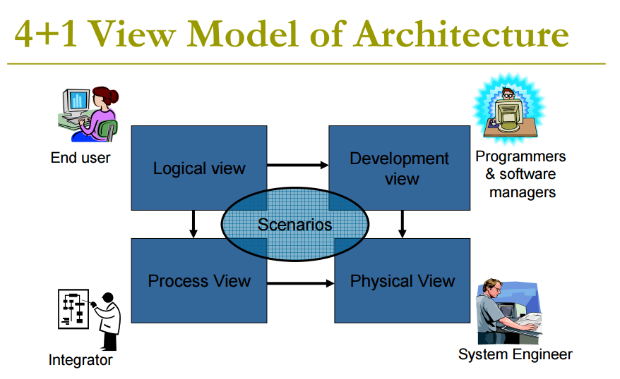

Slide 7
4+1 view model architecture (for distributed systems)
Logical View (or Structural View) - an object model of the design
Process View (or Behavioral View) - concurrency and synchronization aspects
Development View (or Implementation View) - static organization (subset) of the software
Physical View (or Deployment View) - mapping of the software to the hardware
+1. Use-cases View ( or Scenarios) - various usage scenarios

Slide 8
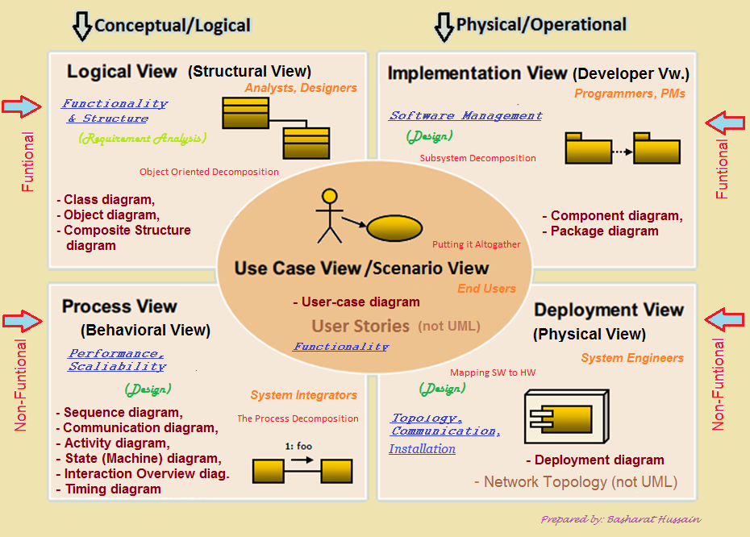
13 UML2.0 diagrams in ‘4+1 View Model’ Architecture

Slide 9


Slide 10

1. Logical View = (The Object-oriented Decomposition)
Viewer: End-user
Considers: Functional Requirements- What the system should provide in terms of services to its users.
What this view shows?
“This view shows the components (objects) of the system as well as their interaction/relationship”.
Notation: Object and dynamic models
UML diagrams: Class, Object, State Machine, Composite Structure diagrams

Slide 11

2. Process View = (The Process Decomposition)
Viewer: Integrator(s)
Considers: Non-Functional Requirements - (concurrency, performance, scalability, usability, resilience, re-use, comprehensibility, economic and technology constraints, trade-offs, and cross-cutting concerns - like security and transaction management)
What this view shows?
“This view shows the processes (workflow rules) of the system and how those processes communicate with each other”.
UML diagrams: Sequence, Communication, Activity, Timing, Interaction Overview diagrams

Slide 12

3. Development/Implementation View = (The Subsystem Decomposition)
Viewer: Programmers and Software Managers
Considers: Software module organization (Hierarchy of layers, software management, reuse, constraints of tools)
What this view shows?
“This view shows the building blocks of the system”.
UML diagrams: Component, Package diagrams
Package Details, Execution Environments, Class Libraries, Layers, Sub-system design

Slide 13

4. Physical/Deployment View = (Software to Hardware Mapping)
Viewer: System Engineers
Considers: Non-functional Requirements for hardware (Topology, Communication)
What this view shows?
“This view shows the system execution environment”.
UML diagrams: Deployment diagrams
Non-UML diagrams: Network Topology (not in UML)
Non-functional

Slide 14

5. Use-case View/Scenarios = (putting it altogether)
Viewer: All users of other views and Evaluators
Considers: System consistency, validity
What this view shows?
“This view shows the Validation and Illustration of system completeness. This view is redundant with other views.”.
UML diagrams: Use-case diagram, User stories

Slide 15
Relationships between Views
The Logical View and the Process View are at a conceptual level and are used from analysis to design.
The Development View and the Deployment View are at the physical level and represent the actual application components built and deployed.
The Logical View and the Development View are tied closer to functionality (functional aspect) . They depict how functionality is modeled and implemented.
The Process View and Deployment View realizes the non-functional aspects using behavioral and physical modeling.
Use Case View leads to structural elements being analyzed in the Logical View and implemented in the Development View. The scenarios in the Use Case View are realized in the Process View and deployed in the Physical View.

Slide 16
Why is it called the 4 + 1 instead of just 5?
The Use-case View: The use case view has a special significance.
Views are effectively redundant (i.e. Views are interconnected).
However, all other views would not be possible without use case view.
It details the high levels requirements of the system.
The other views detail how those requirements are realized.

Slide 17
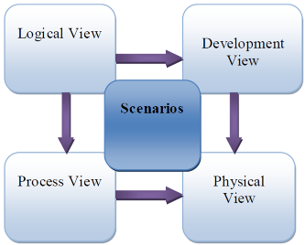
Correspondence between views
Views are interconnected.
They are very close, but the larger the project, the greater the distance.
Start with Logical view (Req. Doc) and Move to Development or Process view and then finally go to Physical view.
From logical to Process view
Two strategies to analyze level of concurrency:
Inside-out: starting from Logical structure
Outside-in: starting from physical structure
From Logical to development view
Grouping to subsystems is based on:
Classes
Class packages
Line of codes
Team organization

Slide 18
Software Architecture Definition by IEEE
“Software Architecture is the fundamental organization of a system, embodied in its components, their relationships to each other and the environment, and the principles governing its design and evolution.”
— The definition of Software Architecture as per IEEE Recommended Practice for Architectural Description of Software Intensive Systems (IEEE 1471-2000)

Slide 19
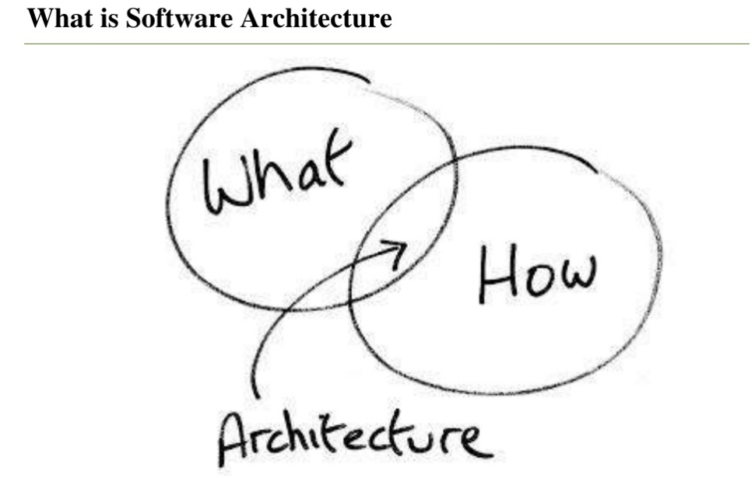

Slide 20
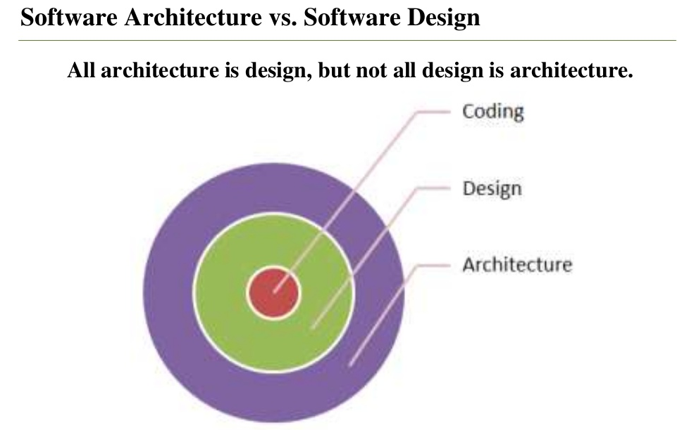

Slide 21
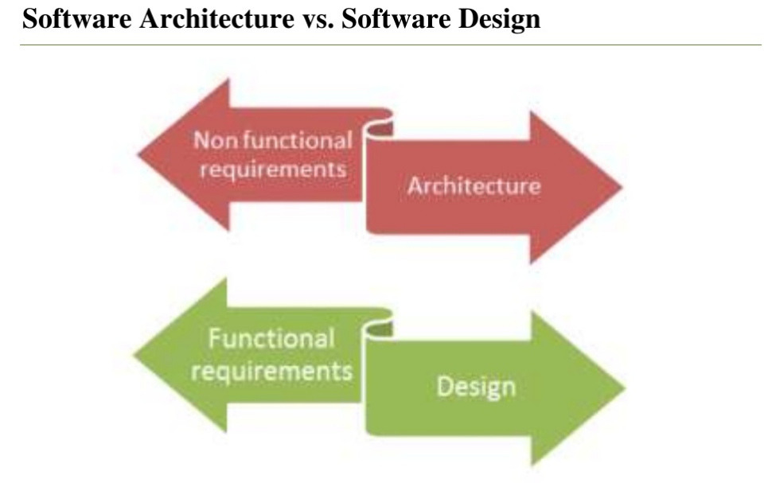

Slide 22
The Notations

Slide 23
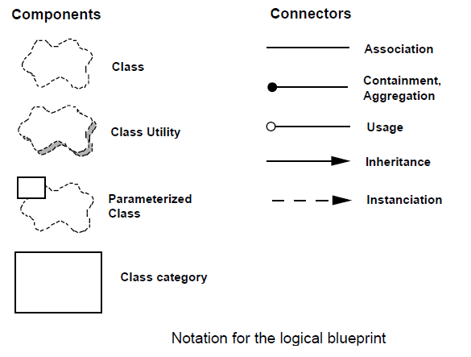
Logical View – Notations (functional requirements)
Class diagrams and class templates are usually used to illustrate the abstraction. Common mechanisms or services are defined in class utilities.

Slide 24
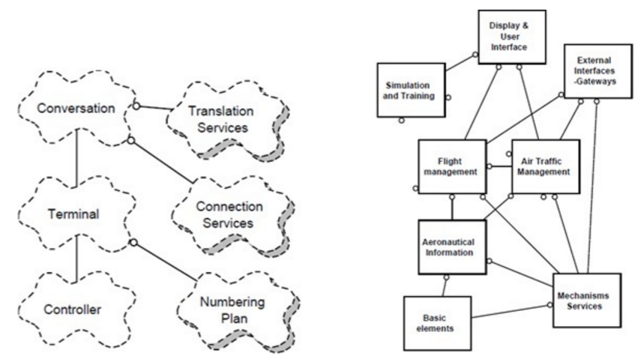
Logical View - Example

Slide 25
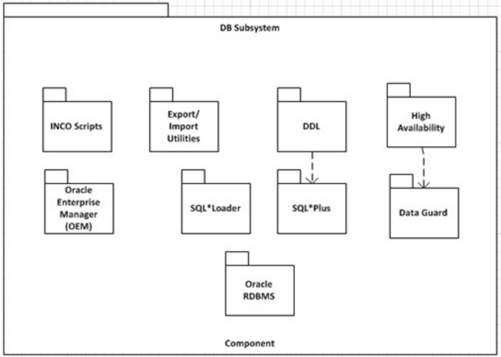
Logical View - Example

Slide 26
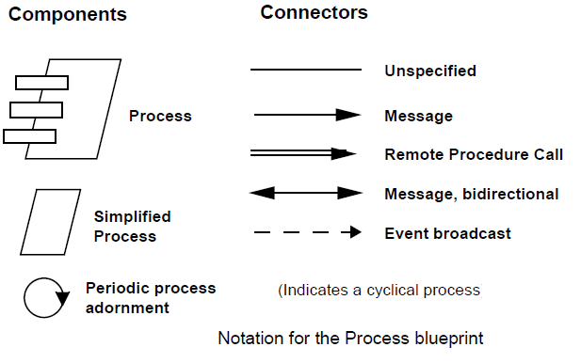
Process View – Notations (Non-functional requirements)
A process is a group of tasks that form an executable unit and which can be (a) tactically controlled, (b) replicated, (c) partitioned into a set of independent tasks: major and minor (cyclic activities, buffering, time-outs).

Slide 27
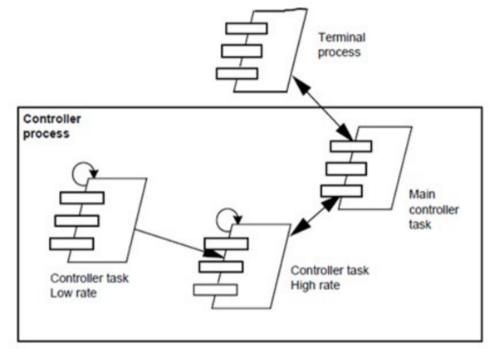
Process View - Example

Slide 28
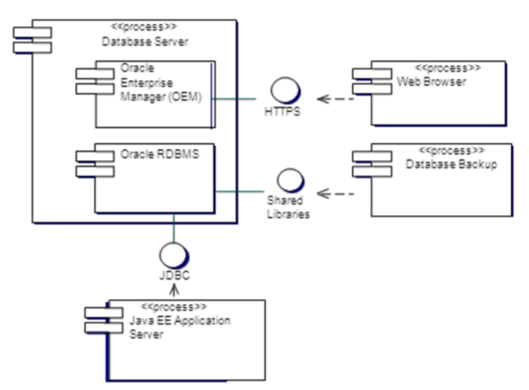
Process View - Example

Slide 29
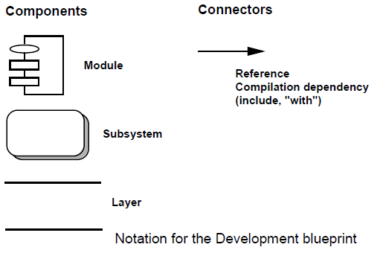
Development/Implementation View - Notation
It consists of libraries and subsystems representation in dev environment. The subsystems are organized into the hierarchy of layers with well-defined interfaces.

Slide 30
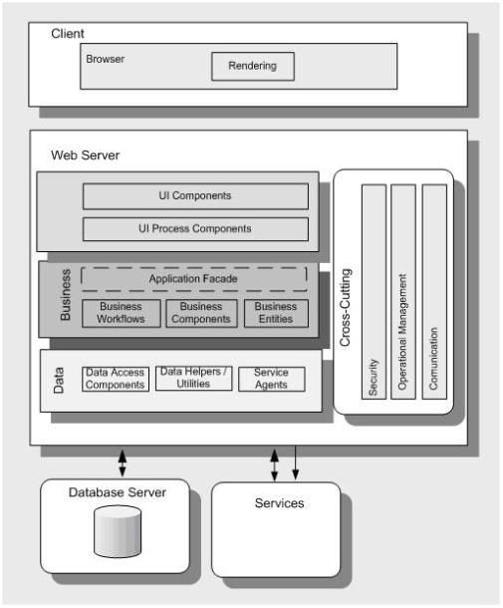
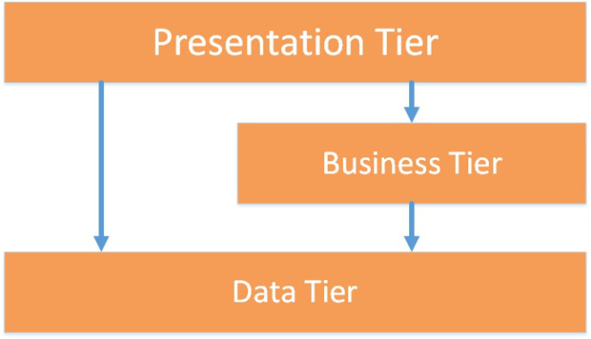
A Typical Layer Model

Slide 31
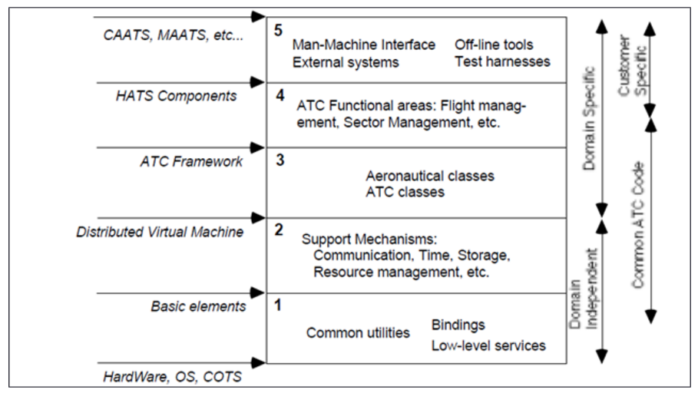
Development View / Implementation View - Example

Slide 32
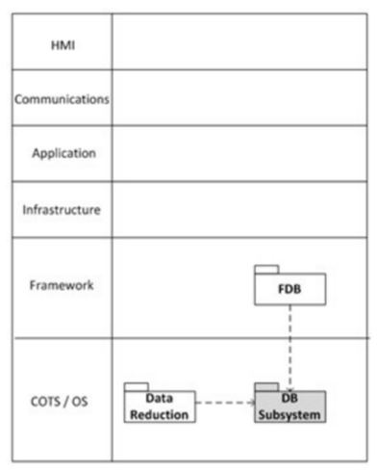
Development View / Implementation View - Example

Slide 33
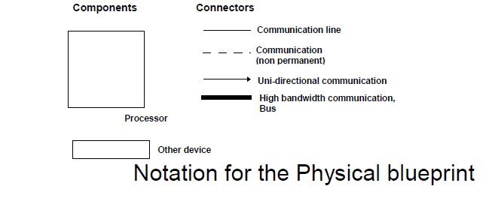
Deployment/Physical View - Notations
Represents non-functional requirements such as availability, reliability, scalability and performance. It shows how networks, processes, tasks and objects are mapped onto the various nodes.

Slide 34
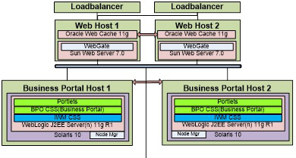
A typical Implementation Model

Slide 35
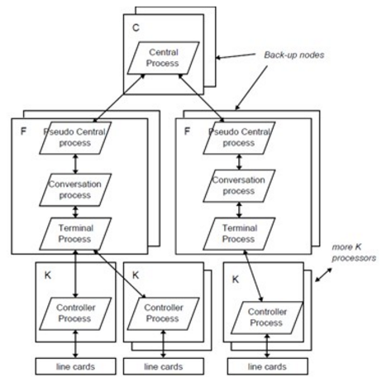
Deployment/Physical View - Example

Slide 36
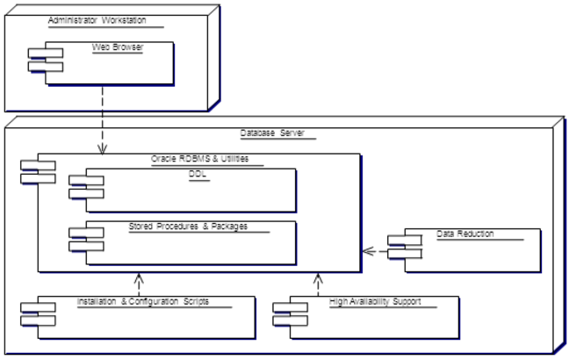
Deployment/Physical View - Example

Slide 37
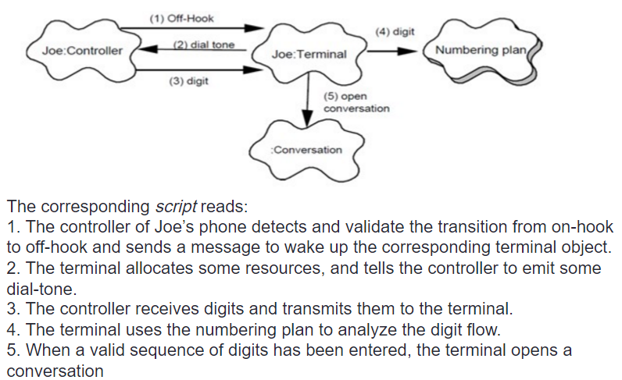
Scenarios / Use Case Model (Small PABX)

Slide 38
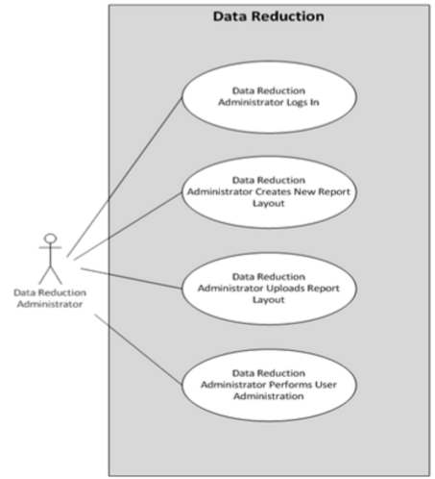
Scenarios / Use Case Model (Small PABX)

Slide 39
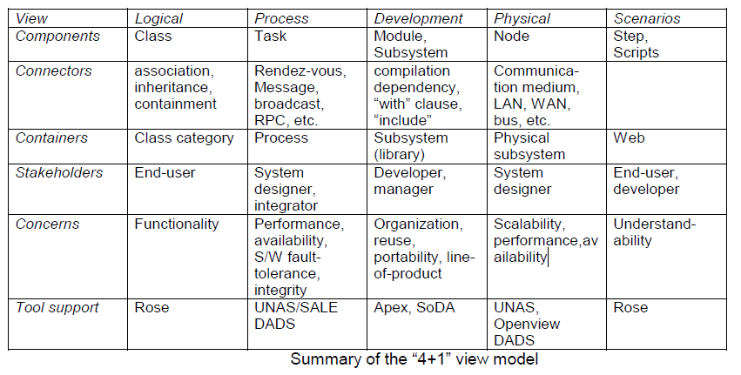
Summary

Slide 40
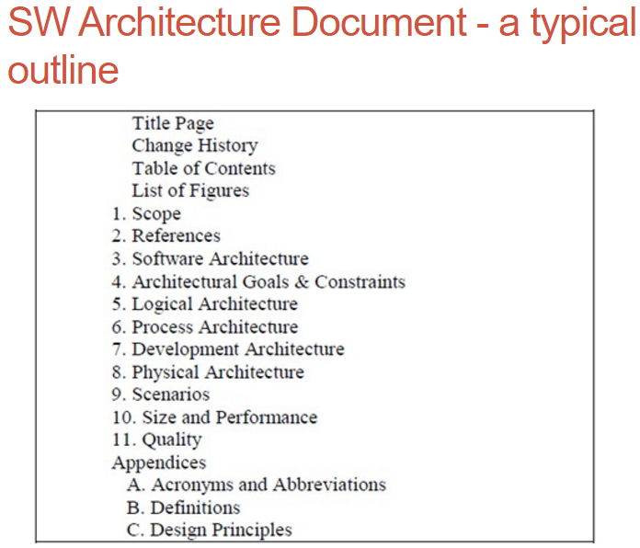

Slide 41
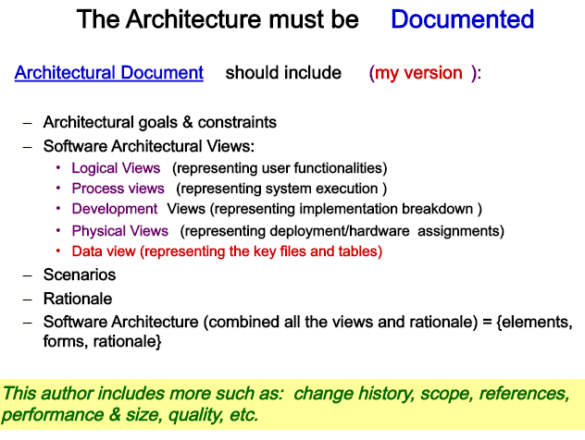

Slide 42
Enterprise Architecture
If Solution Architecture is analogy to Building Blueprint, then Enterprise Architecture will be analogy to City Blueprint.
The scope of Enterprise Architecture covers the entire enterprise rather than just 1 business unit.

Slide 43
Definition of Enterprise Architecture
The MIT Center for Information Systems Research (MIT CISR) in 2007 defined enterprise architecture as:
“Enterprise architecture is the organizing logic for business processes and IT infrastructure reflecting the integration and standardization requirements of the company’s operating model. The operating model is the desired state of business process integration and business process standardization for delivering goods and services to customers”.

Slide 44
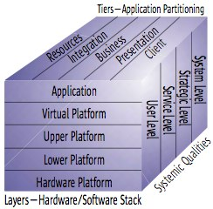
Sun Tone Cube Architecture (Partitioning)
The Sun Tone cubic shows a 3 dimensional cube that represent 3 important aspect of technology architecture.
Tiers: Represent the separation of concern
Layers: Hardware and Software Stack
Systemic Qualities: cross functional
requirements of the IT System.

Slide 45
Still - One Size Does Not Fit All
The architect community hasn’t agreed on a “Unified Architecture Method”.

Slide 46
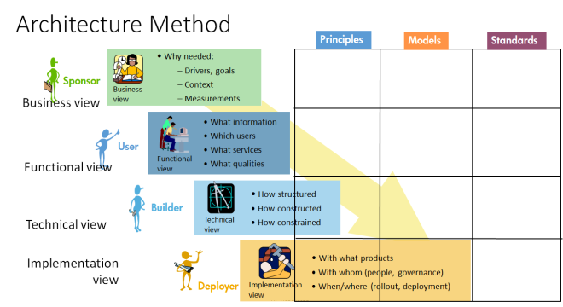
HP Global Method for ITSA

Slide 47
This architecture method comprises of the following views:
Business view : The business view gives the business sponsor’s prospective on ‘why we are doing it?’ The drivers, goals, context and measurements.
Functional view : The functional view illustrates a system from a user’s perspective. It gives answers to the ‘What’ questions: What is the information, for which users, what are the services and at what qualities.
Technical view : The application view illustrates a system from a builder’s perspective and answer the ‘How’ questions: how the system will be structured, how it will be constructed, how are the constraint handled?
Implementation view : The infrastructure view depicts the system from a Deployer’s point-of-view. It answers the ‘With’ questions: With what product, with whom (people, governance), When/Where (rollout, deployment).

Slide 48
Each view defines Architecture Principle, Architecture Model and Architecture Standards.
1. Architecture Principle: Principles are general rules and guidelines, intended to be enduring and seldom amended, that inform the way in which an organization sets about fulfilling its mission. For example, if a person’s principle is to “have integrity”. That will guide his actions and decisions; He would most likely have a behavior standard not to steal. Therefore architecture principle provides the guidance to architecture standards that is actionable. (Standard may be more likely subjected to changed than Principle). The format for Defining Principles is:
Name: Principle Name
Statement: Unambiguous statement that communicate the fundamental rule.
Rationale: Describe why the principle is established.
Implications: Describe the requirements, both business and IT, for carrying out the principle.
2. Model: Diagram that describe the architecture view.
3. Architecture Standard: Standards are rules for how to define the structure throughout the architecture. Taking the same example on ‘Integrity’ principle, the standard may be “When I found a wallet that does not belongs to me, I will return it to the police station.” Notice that the standard is actionable and design directly take reference to this standard and must comply with the architecture standard.

Slide 49
A good architecture method should give guidance on how to address the coherence between architecture views. The HP Global Method achieves views coherence through Architecture Principles. Architect first defines the Business Architecture Principle, then derives the Functional Architecture Principle and followed by Technical and Implementation Architecture Principles. These principles once finalized, forms the guiding principles for the definitions of model and standard in each of its respective view.

Slide 50
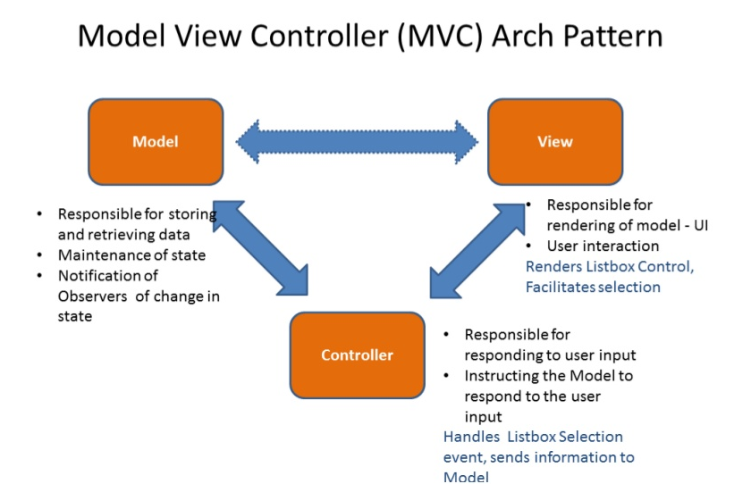

Slide 51
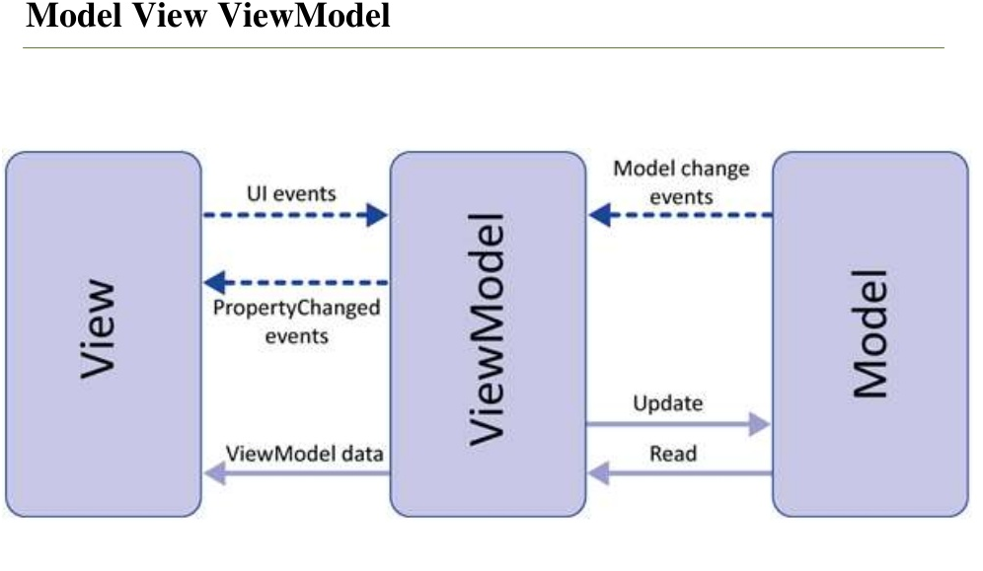

Slide 52
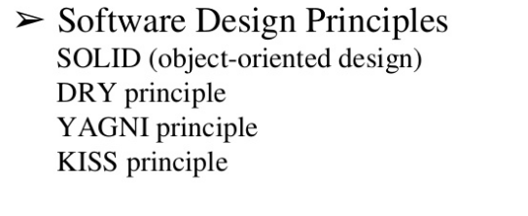
Software Design Principles

Slide 53
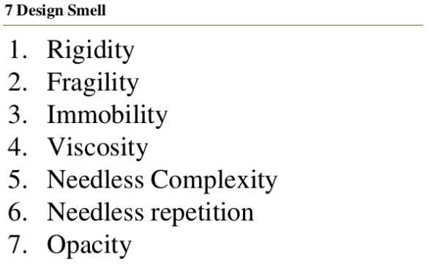
Design Smells

Slide 54
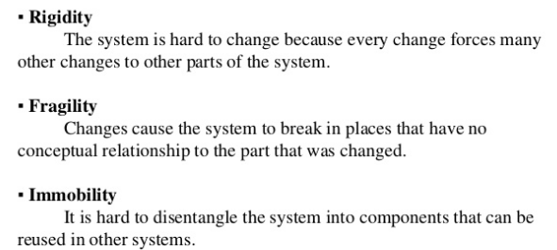
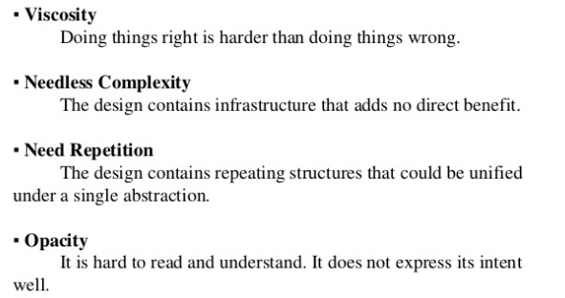
7 Design Smells

Slide 55
The End

